Slide 1

Software Presentation
Open Project
Group 2
Tatiana Uklist
Tanner Waggoner
Kevin Maldonado
Sami Eldaw
Charaf Lachouri

Slide 2
History of OpenProject
Redmine
June 2006
ChiliProject
Feb 2011
OpenProject
October 2012
OpenProject Foundation
April 2013
Notes:
OpenProject has been developed since 2010 along with its ancestor project ChiliProject.^{[10]} The initial motivation for this fork was the OPF founding members' performance, security, and accessibility requirements, which could not be easily reached by plugins for either Redmine or ChiliProject.

Slide 3
Industries that use OpenProject the most
Hospital and Health Care
Computer Software
Information Technology and Services
Oil and Energy
Internet

Slide 4



Slide 5
Features
Project Portfolio and Planning
Team Planner
Customizable Project Reports
Agile, Kanban and Scrum Options
Version Boards
WBS
Team Collaboration and Tracking
Live feed to updates
Track labor and unit costs
Other Features
Data encryption
Add-ons for construction industry
Native Language support

Slide 6
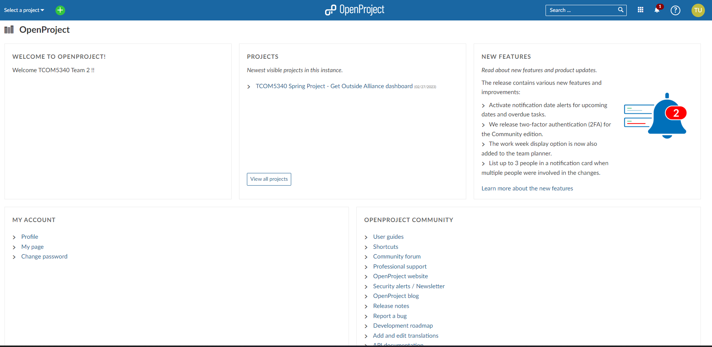
Overall Interface

Slide 7
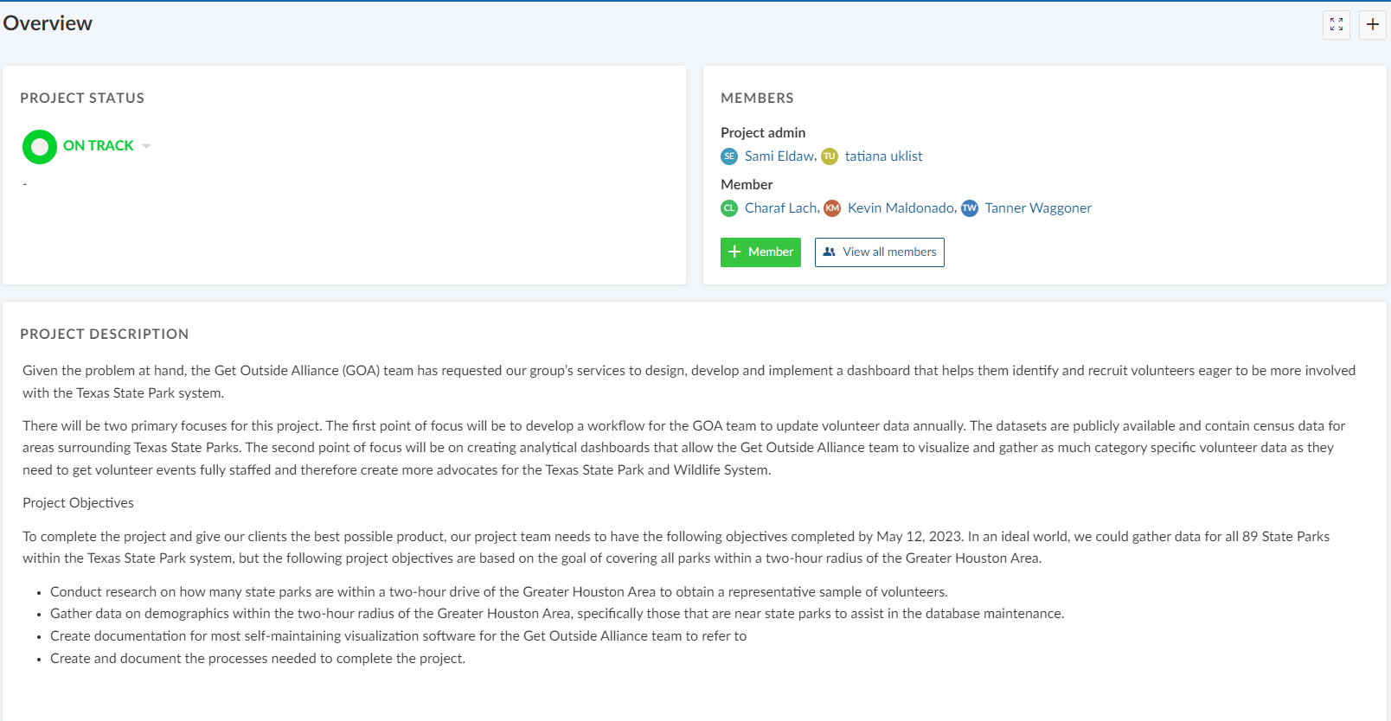
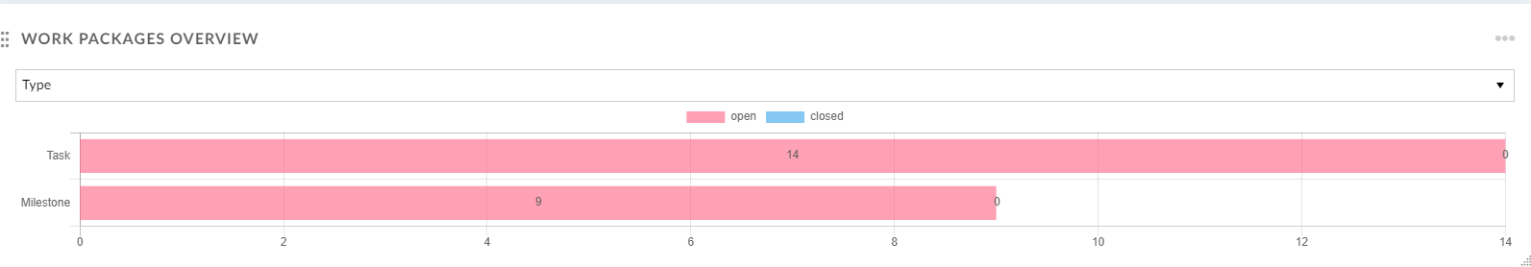
Project Interface
1
2
3
4

Slide 8
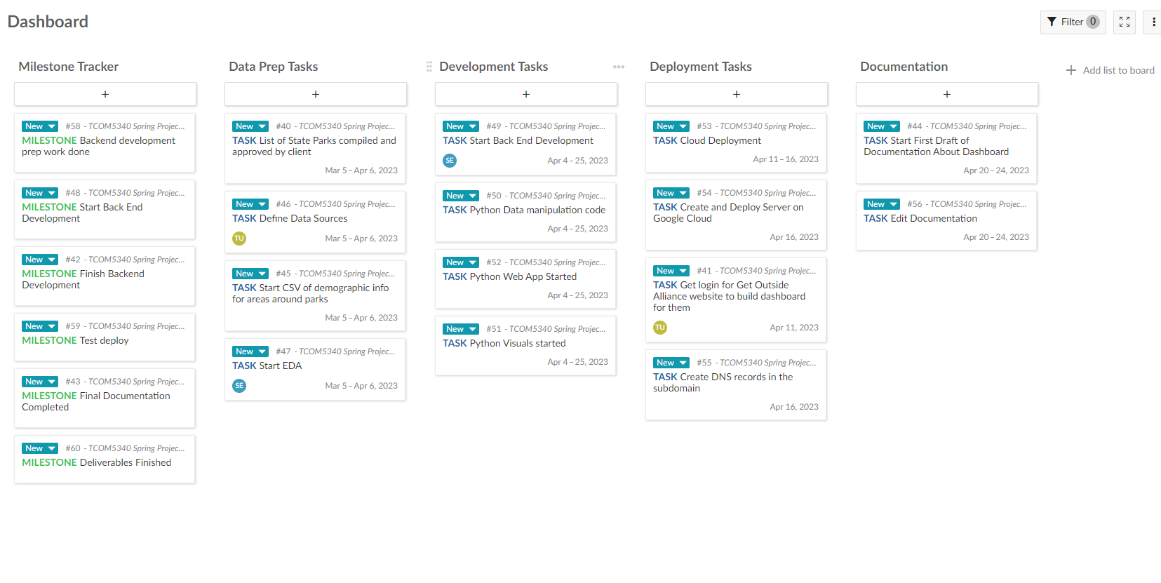
Dashboard Interface

Slide 9
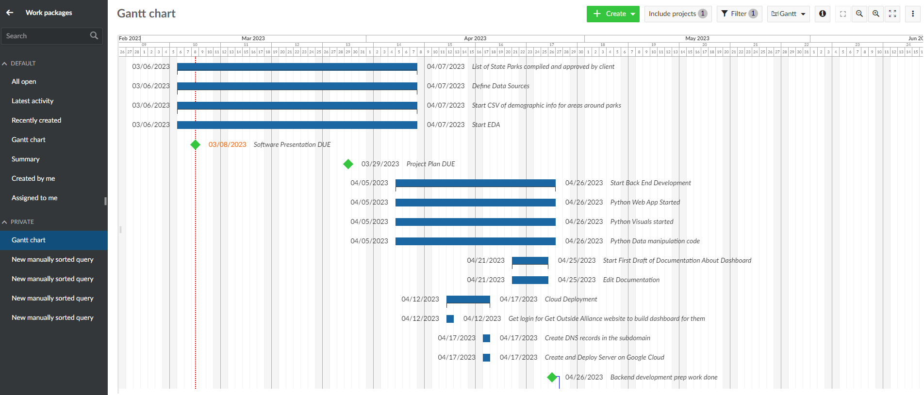
Individual Interface

Slide 10
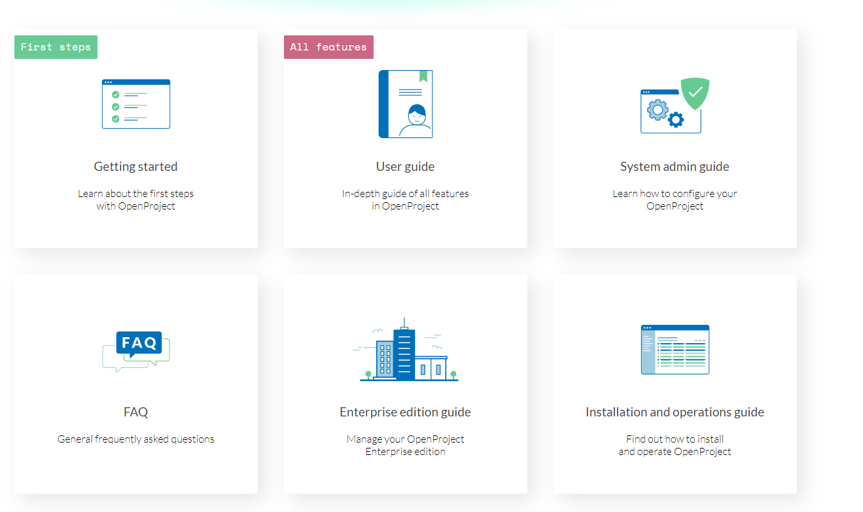
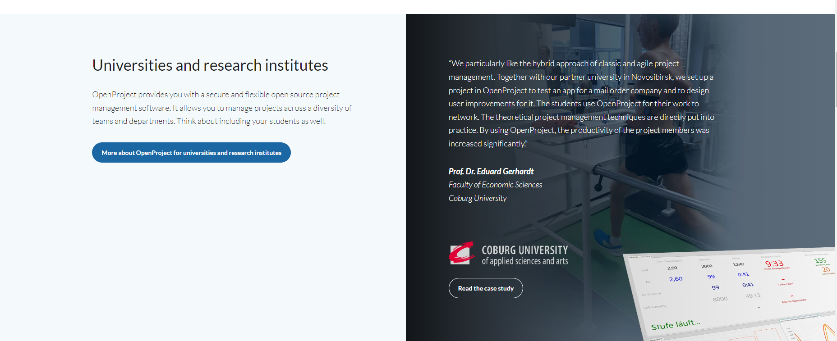
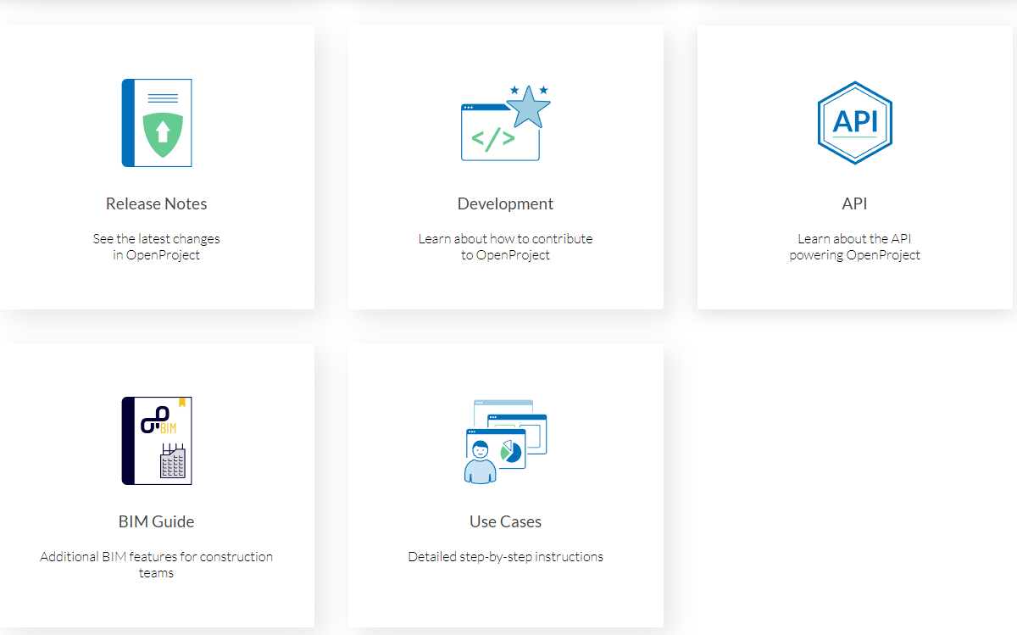
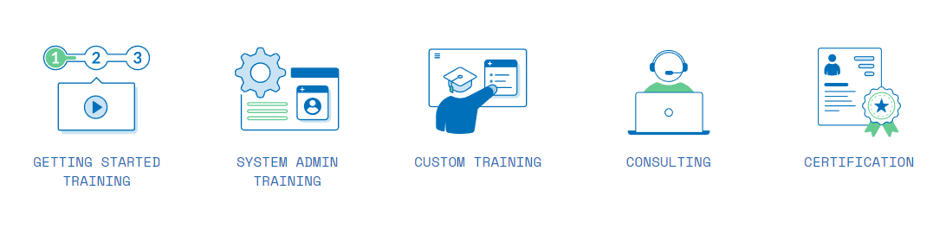
Support and Resource Options

Slide 11

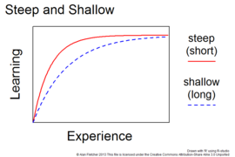

Constraints

